Slide 1


FLIGHT TICKET BOOKING USING MERN

Slide 2
TEAM MEMBERS
Logeshwaran V – 210121104026
Mahesh K - 210121104027
Hariharasudhan K - 210121104016
Danian J - 210121104013

Slide 3
TABLE OF CONTENTS
Introduction
Website architecture
Technologies used
Functional demo

Slide 4
INTRODUCTION
The Flight Ticket Booking System, built using the MERN stack (MongoDB, Express.js, React, Node.js), aims to provide a seamless platform for users to search, compare, and book flights. It ensures a user-friendly interface, secure payment processing, and personalized flight recommendations. The system is designed to handle scalability, offer real-time updates, and simplify the booking process with efficient search and filtering options, creating a modern and reliable solution for flight ticket reservations.

Slide 5
TECHNOLOGIES USED
Front End Technology:
React
React-Router
React-Redux
React-Bootstrap
Html
Css
Back End Technology:
Node
Express
MongoDb

Slide 6
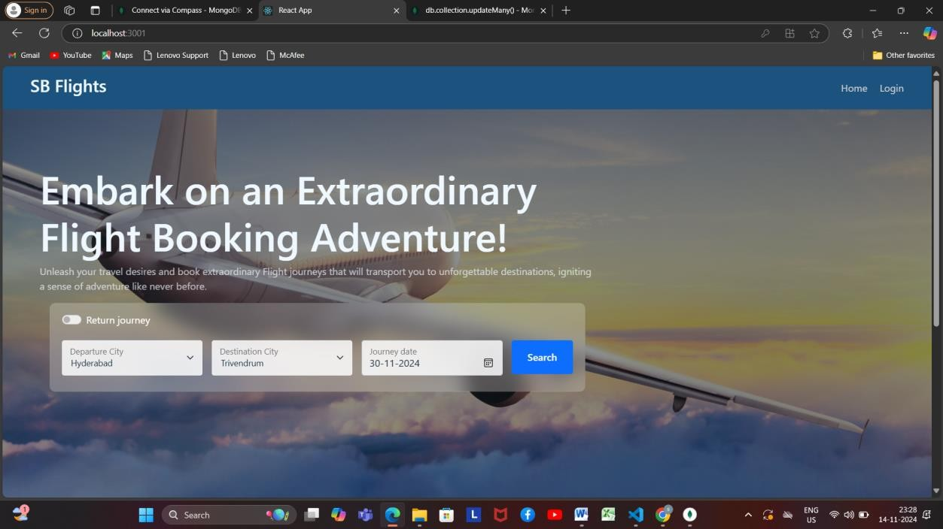
HOME PAGE

Slide 7
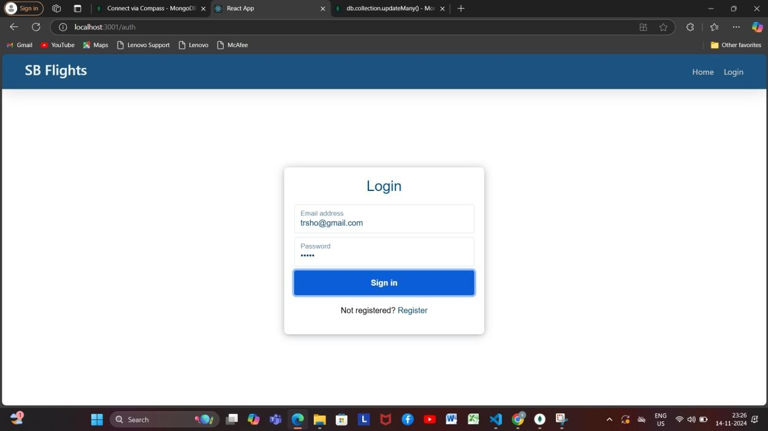
LOGIN PAGE

Slide 8
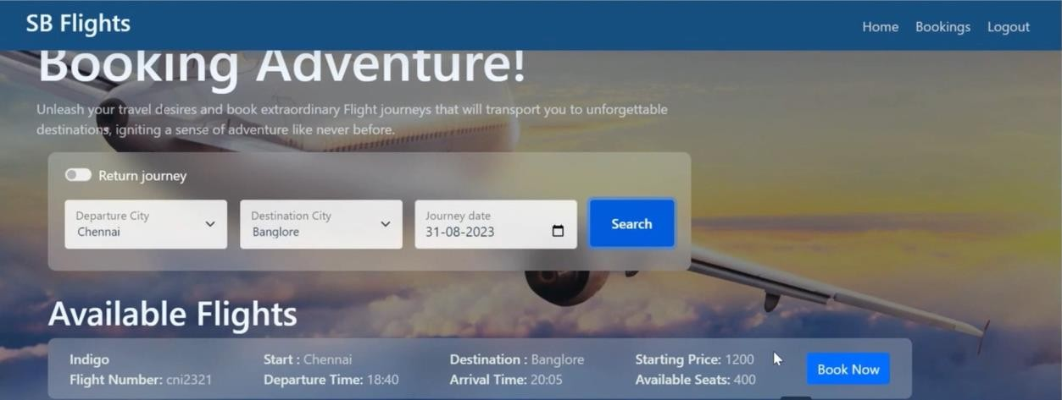
AVAILABLE FLIGHTS

Slide 9
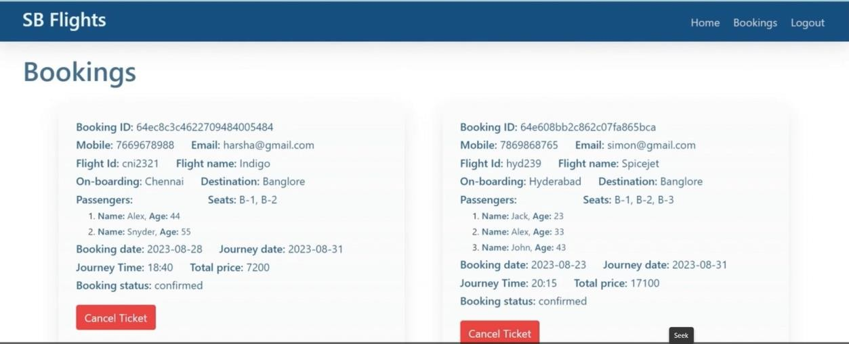
BOOKINGS REVIEW

Slide 10
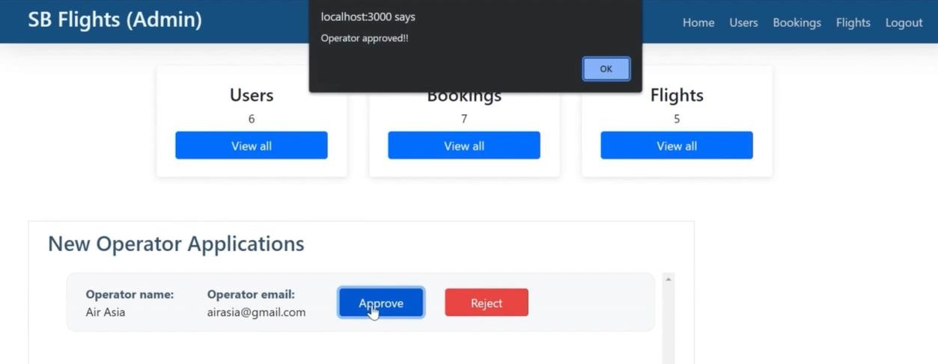
ADMIN

